Slide 1
CTE Portal CIP Self-Review
& the
Office of Career and Technical Education
Michigan Department of Education
2024 Career Conference
Notes:
Candace/Jim – Candace introduce

Slide 2
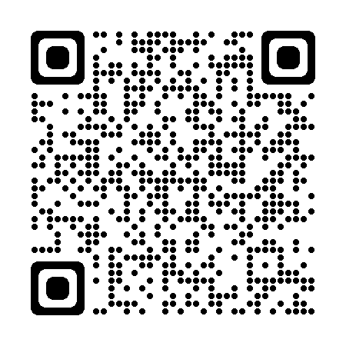
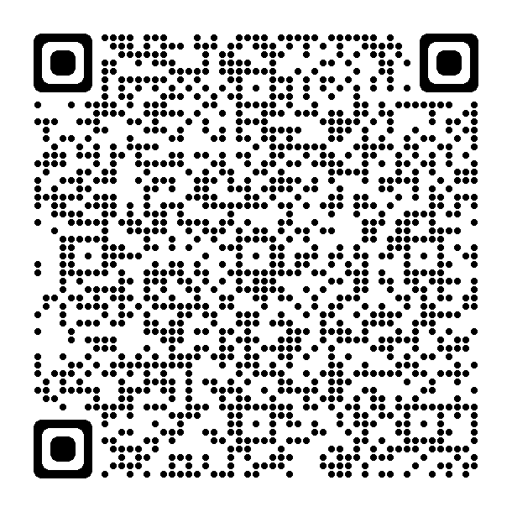

Resources
MDE - CIP Self-Review
CIP Self-Review Form
CTE Program Toolkits
Notes:
Candace – reference documents briefly, introduce JIM. Jim – show admin how to access the CIP Self Review and what the main contact page looks like.

Slide 3
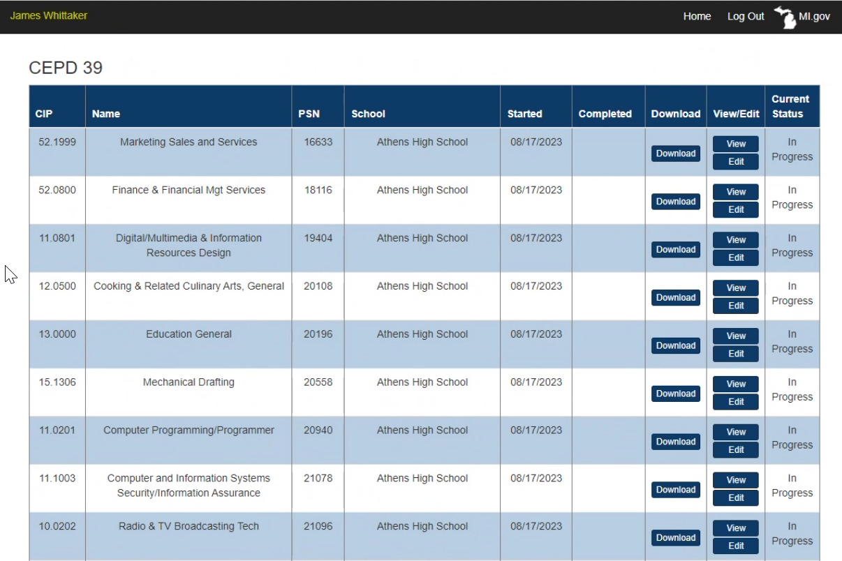

Starting & Completion Dates
Annual Snapshot of Your Program
Notes:
Jim – review status page.

Slide 4

C01
Program Teacher Certification
Target Completion Date: November 1

Slide 5
Manage Contacts Page
Primary Instructor
Administrator’s Information
CEPD Administrator’s Information
Complete ASAP at beginning of school year.

Slide 6
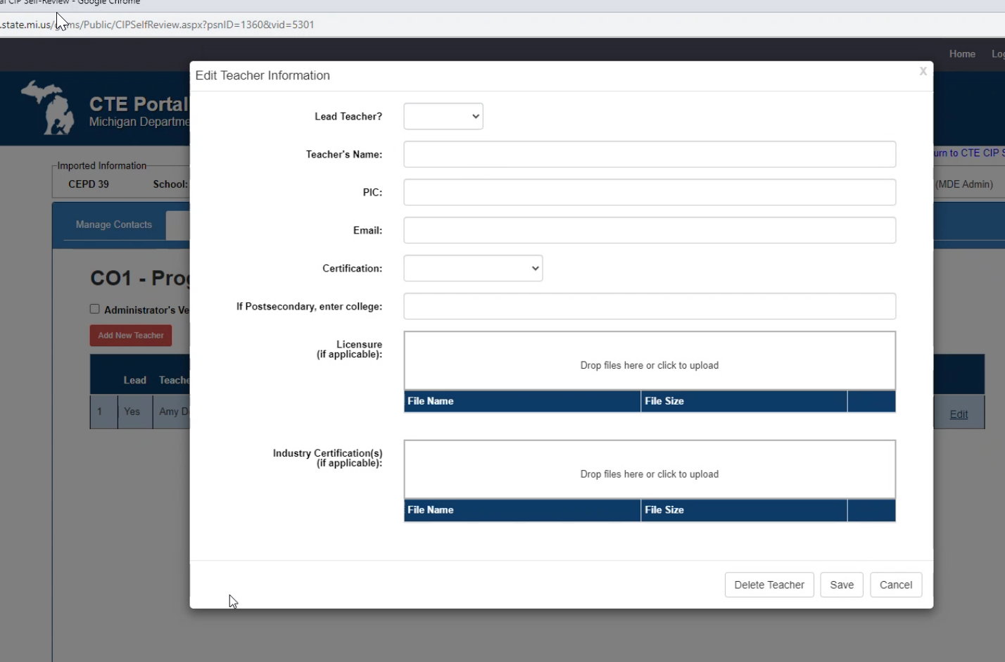
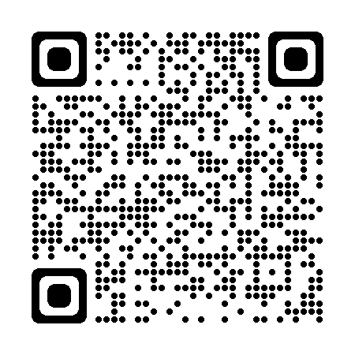
C01
Program Teacher Certification
Match MOECS
Licensure
Industry Cert
Postsecondary?
Notes:
Stress that a teacher can not be in the classroom without appropriate certification – they MUST show in MOECS if they are in the classroom with the appropriate CIP code.

Slide 7
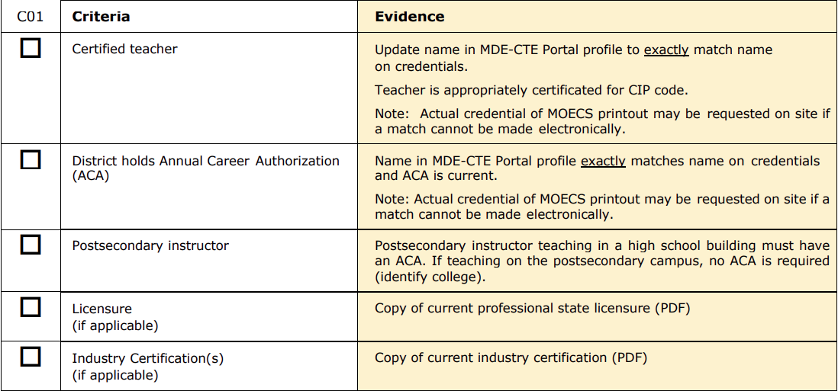
C01 Evidence
Update as necessary to keep current

Slide 8

C02
Program Teacher Professional Development

Slide 9
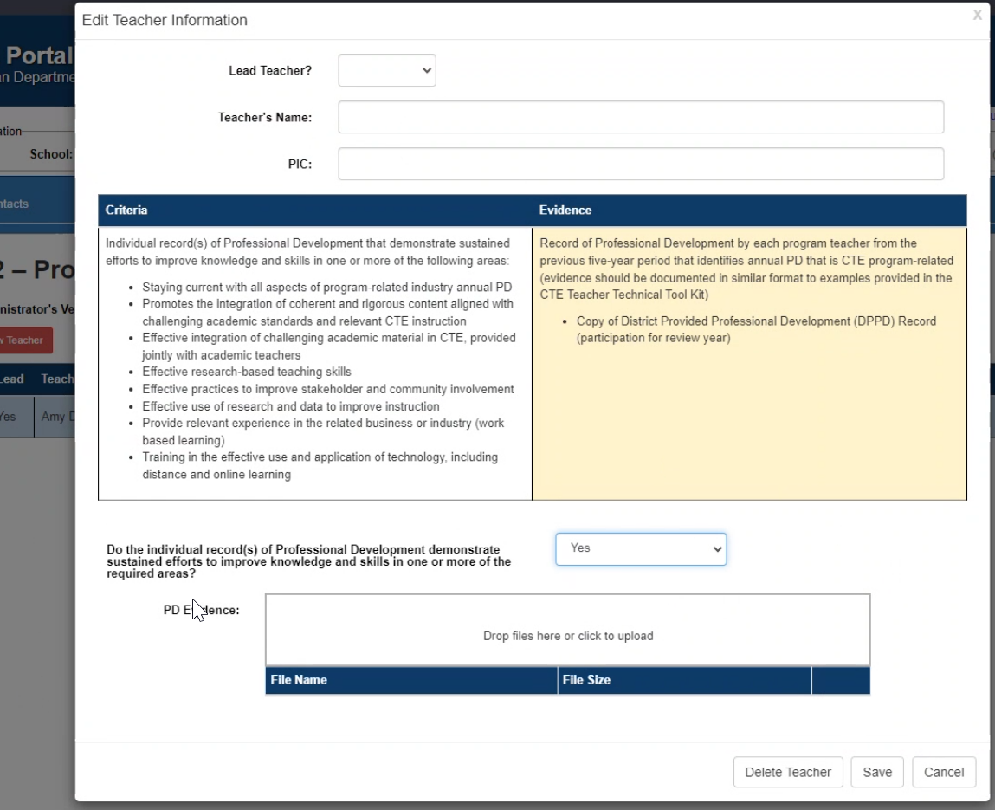
C02
Professional Development
Annual
CIP-specific
Options?
Notes:
QR to events page?

Slide 10
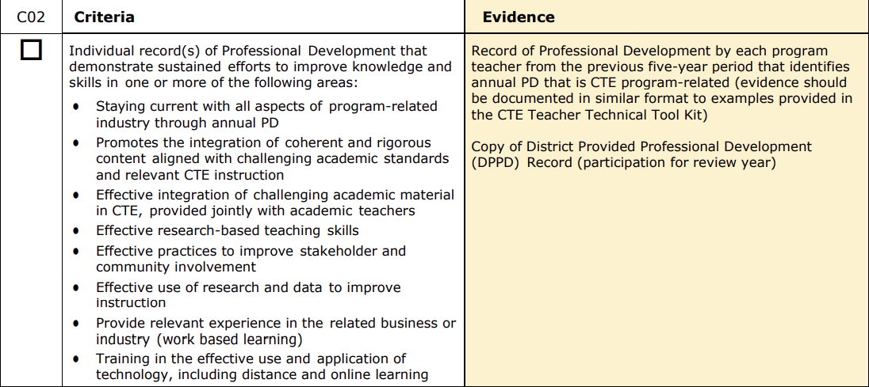
C02 Evidence
Use MOECS record in May/June

Slide 11
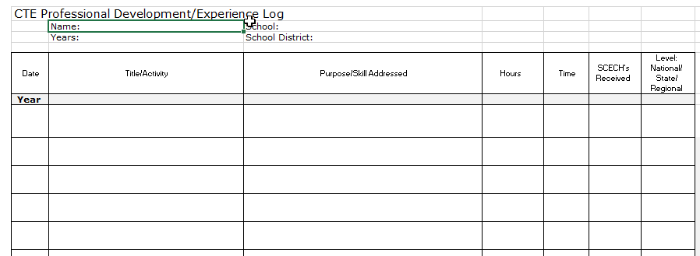
C02 Template
No OCTE hour requirement

Slide 12

C03
Program Advisory Committee

Slide 13
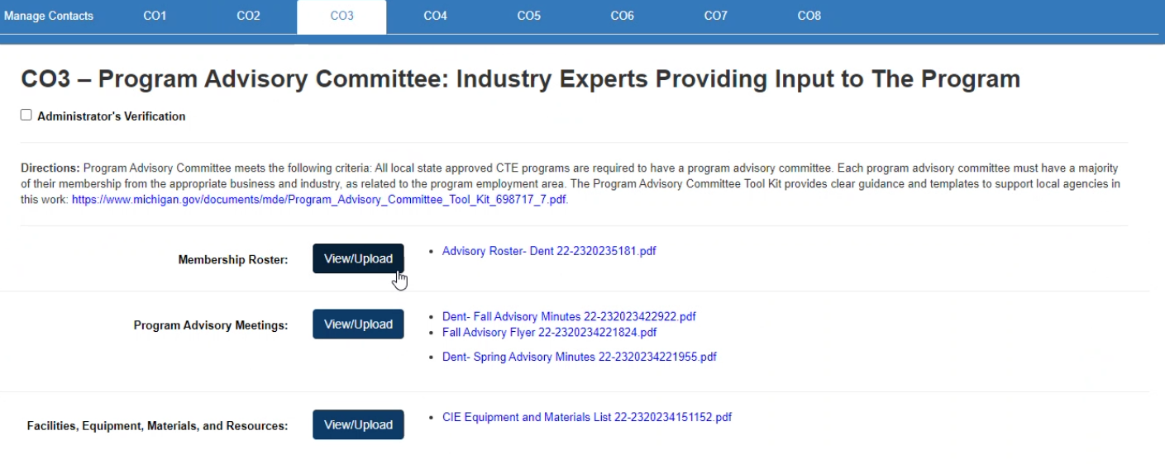
C03
Program Advisory Committee
Majority from business and industry
Two meetings per year
Notes:
Point out that

Slide 14
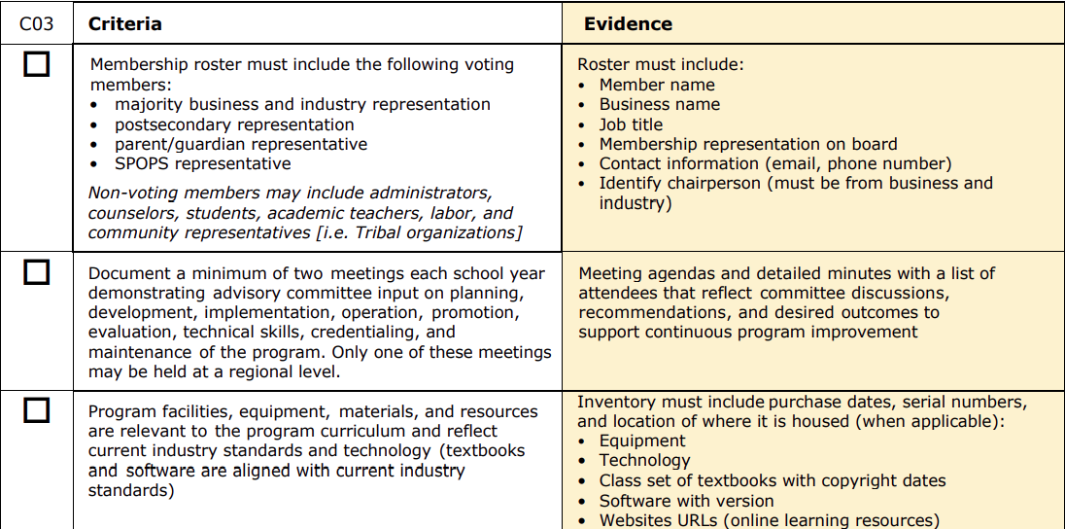
C03 Evidence
Upload when necessary
Upload agenda/ minutes after Fall & Spring meetings
Upload when necessary

Slide 15
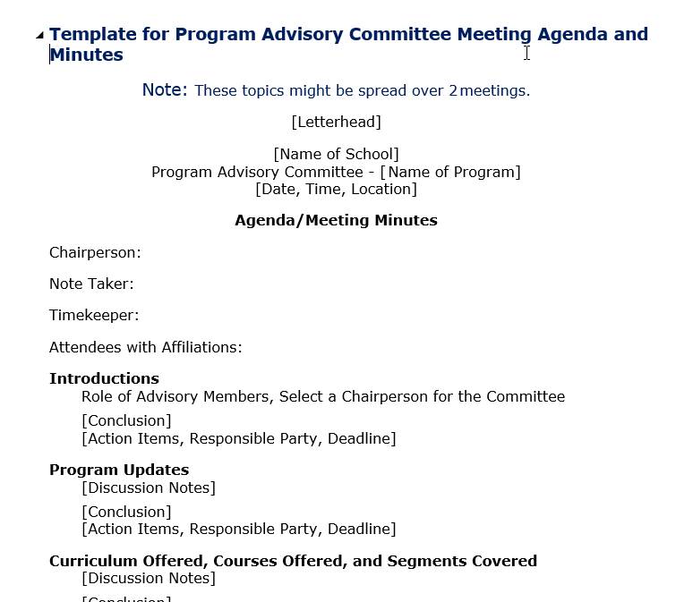
C03 Template - Agenda

Slide 16
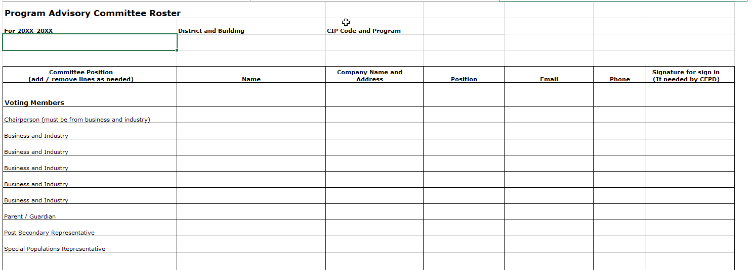
C03 Template – Required Members

Slide 17
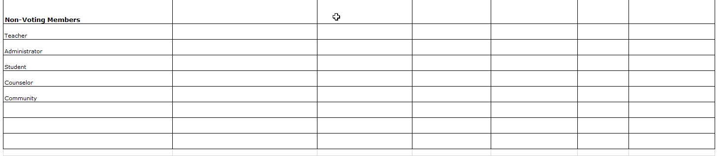
C03 Template – Non-Voting Members

Slide 18

C04
Program Delivery – Curriculum and Instruction

Slide 19
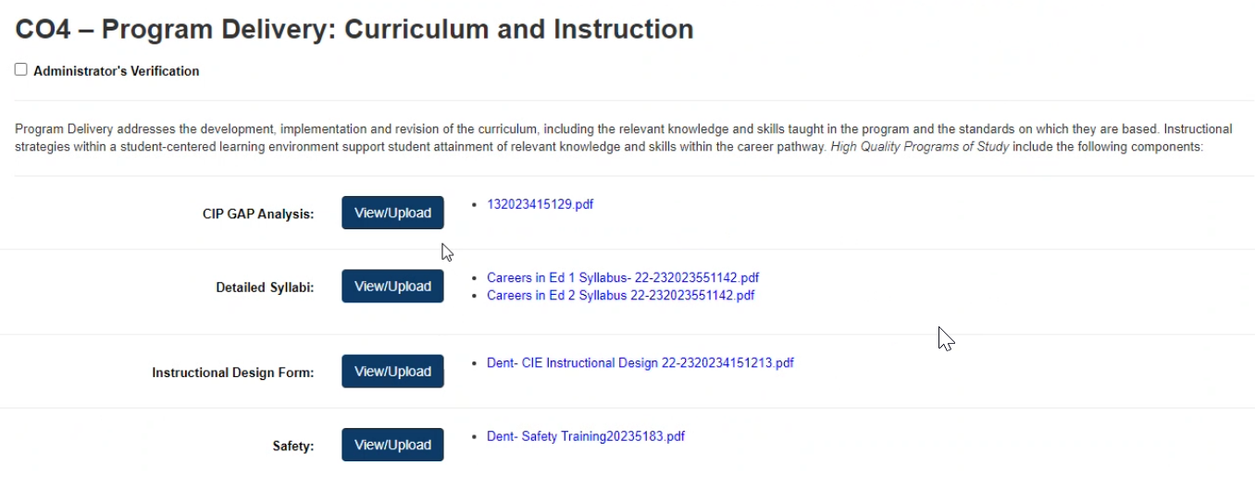
C04
Program Delivery
No Gap after Career Pathways Grant (CPG) process is complete ☺
Syllabus for each local class in program
Safety descriptions

Slide 20
C04 Evidence
Upload annually
Upload annually
Upload when necessary
Upload when necessary

Slide 21
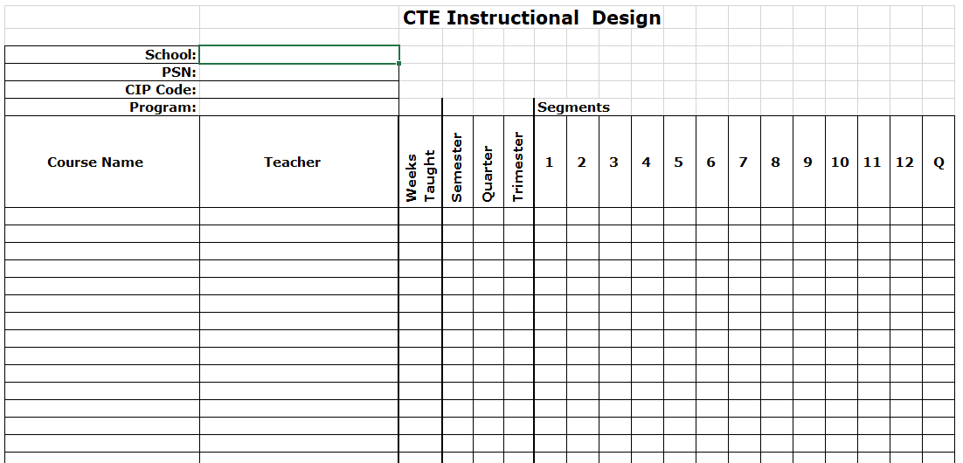
C04 Template – Perkins IV
For programs using segments

Slide 22
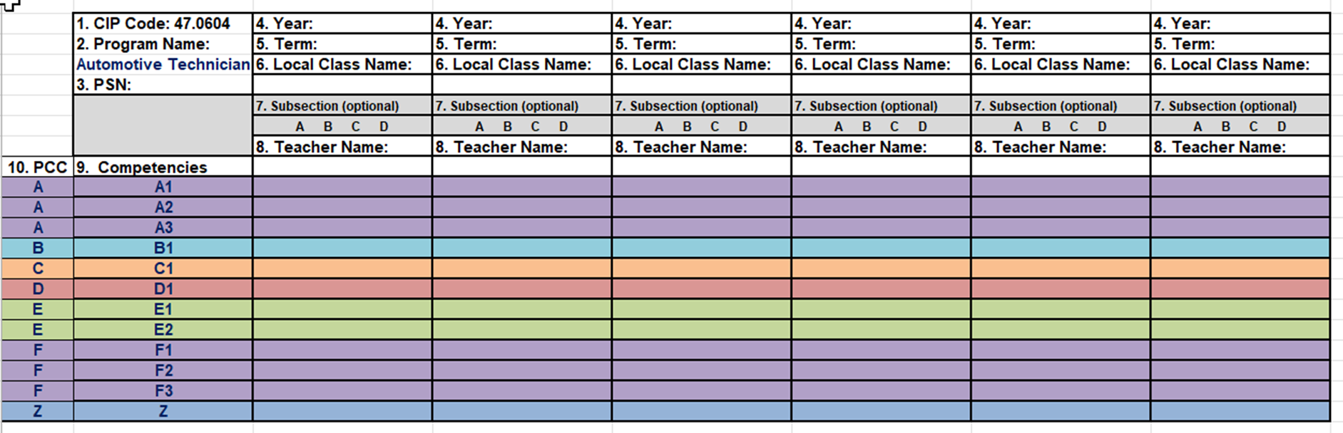
C04 Template – Perkins V
Programs with CPG competencies

Slide 23
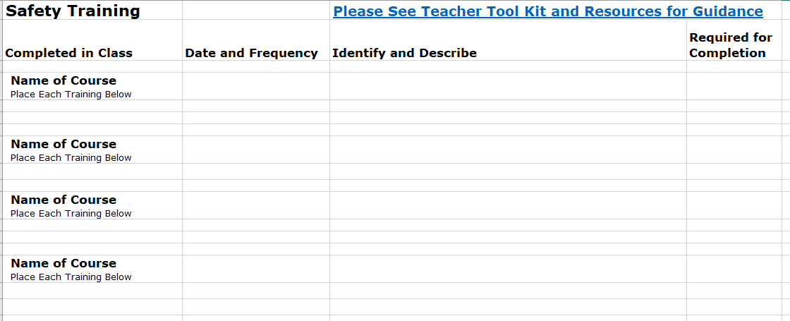
C04 Template - Safety
Can be generic versus specific
General description of activity

Slide 24

C05
Work-Based Learning (WBL)

Slide 25

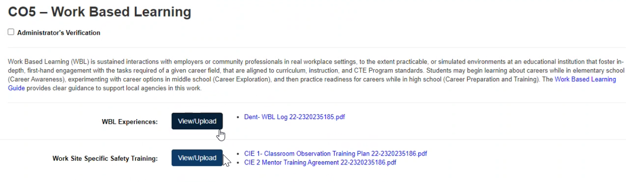
C05
Work-Based Learning
General description
Samples
WBL Continuum

Slide 26
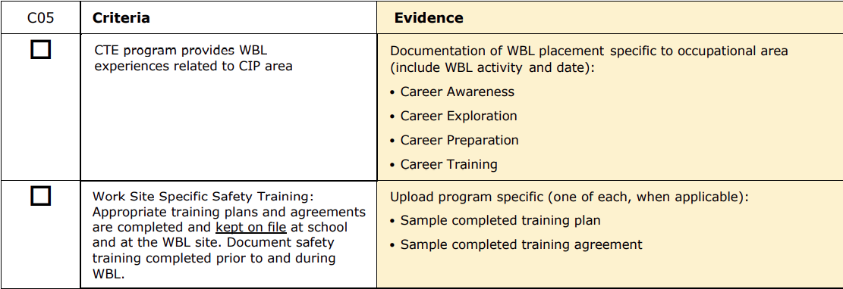
C05 Evidence
Upload when necessary

Slide 27
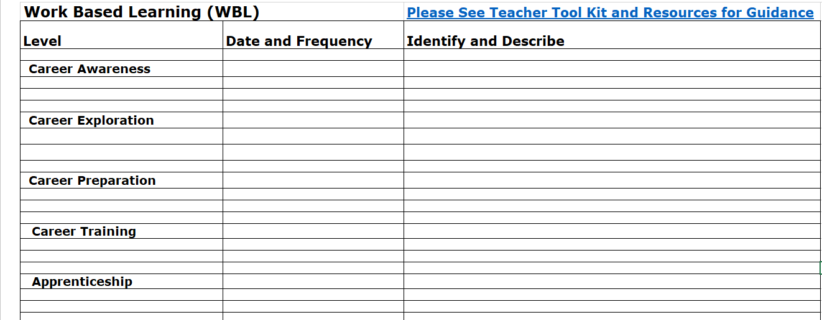
C05 Template
Upload when necessary
Can be generic versus specific
General description of activity

Slide 28

Caution!

Slide 29

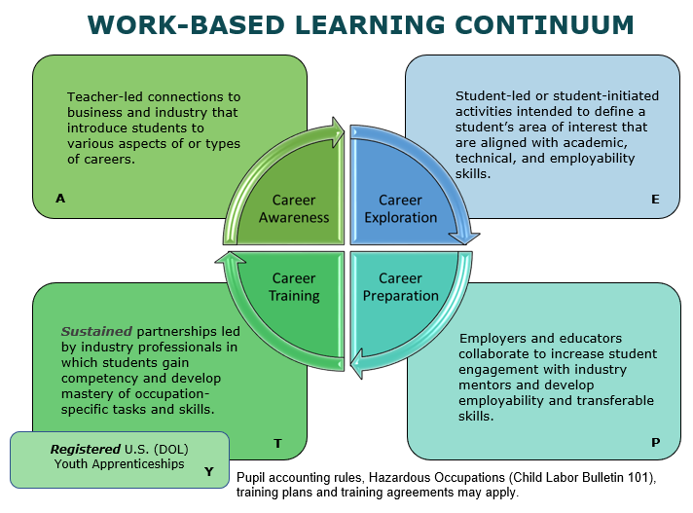

Slide 30
Recording Guidelines
Training Agreement/Plan?
Yes
No
One entry per training agreement/plan
One entry per category per business partner
Notes:
We’re going to continue to work on reporting guidelines and helping teachers to understand which category to report and when. Having accurate data will help us tell our story as a state and showcase the great things our CTE students are doing. You all can help us by continuing to check for understanding and to assist teachers as well.
And please let me know what types of reports would be most helpful to you, so we can ask our partners at PTD to help create those for us.

Slide 31

C06
Student Leadership &
Career and Technical Student
Organizations (CTSOs)

Slide 32
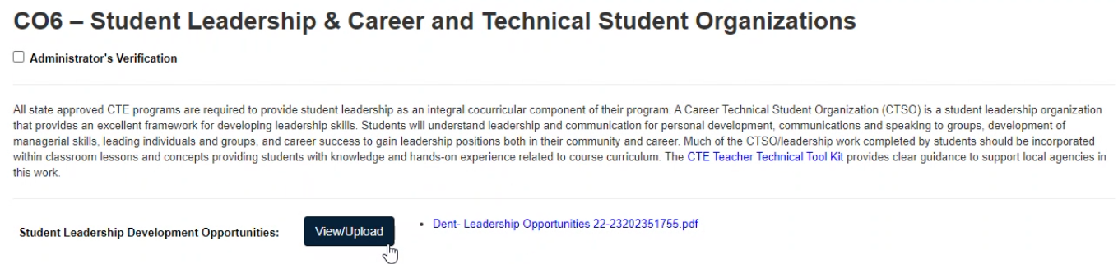
C06
Student Leadership
Not just a roster!
Can be CTSO or local activities

Slide 33
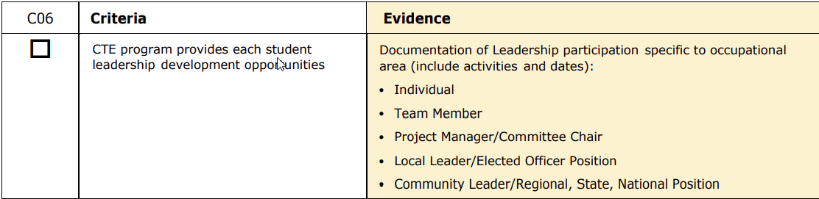
C06 Evidence
Upload when necessary

Slide 34
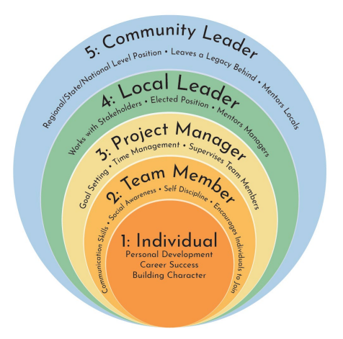
C06 – Leadership Model

Slide 35
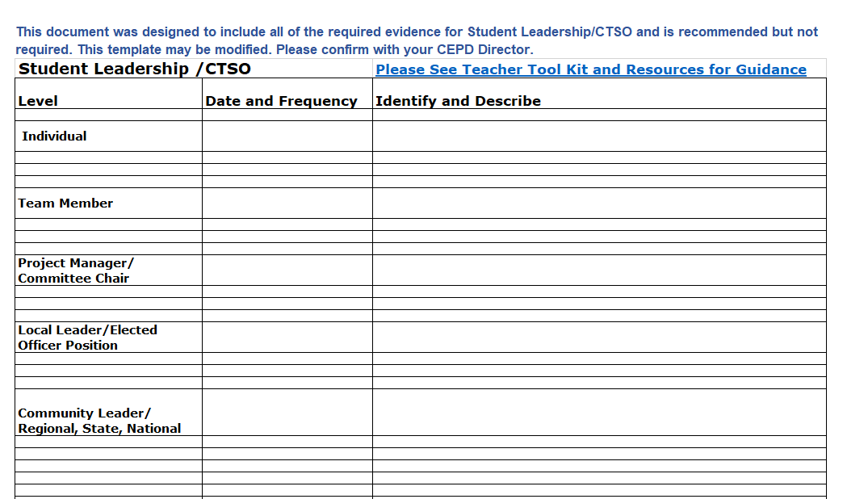
C06 Template
Can be generic versus specific
General description of activity

Slide 36

C07
Equity and Access

Slide 37
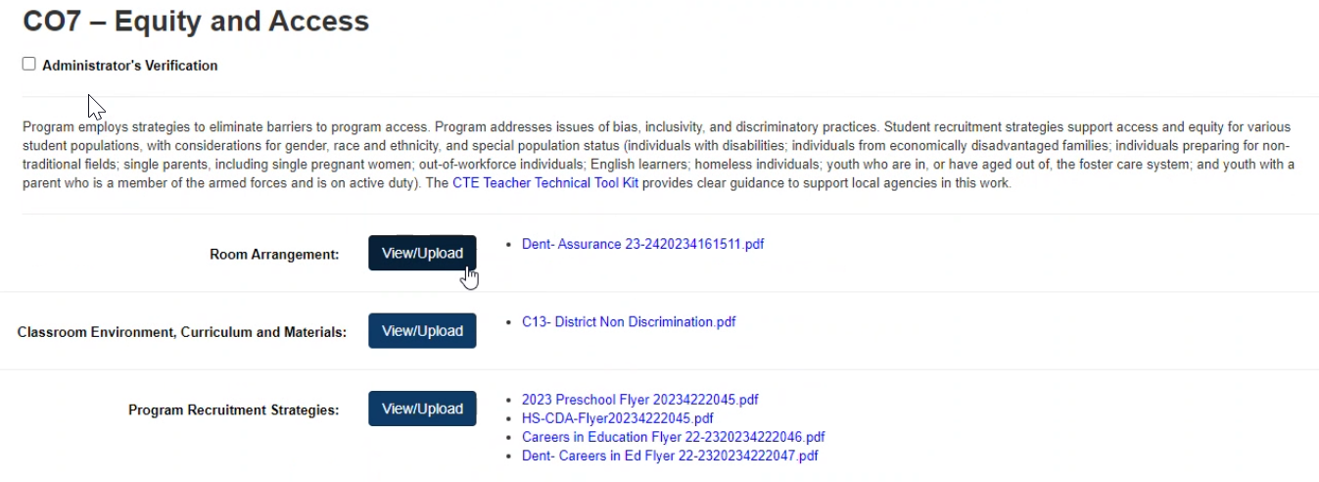
C07
Equity and Access
Access to programs
Access to opportunities
Meets diverse needs

Slide 38
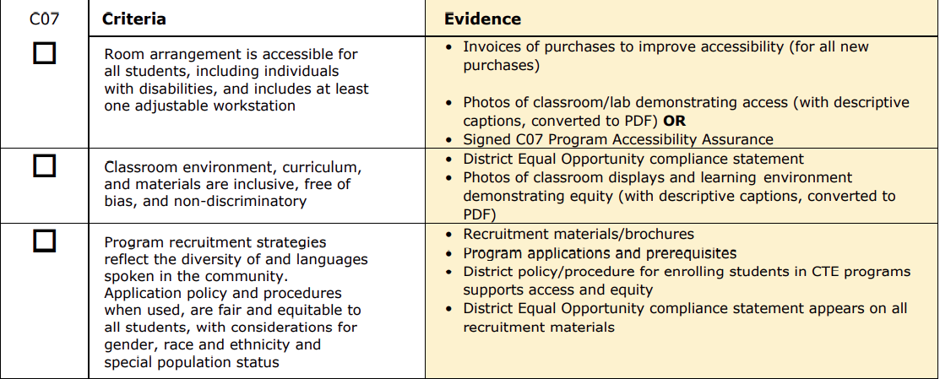
C07 Evidence
Specific evidences; upload when necessary

Slide 39
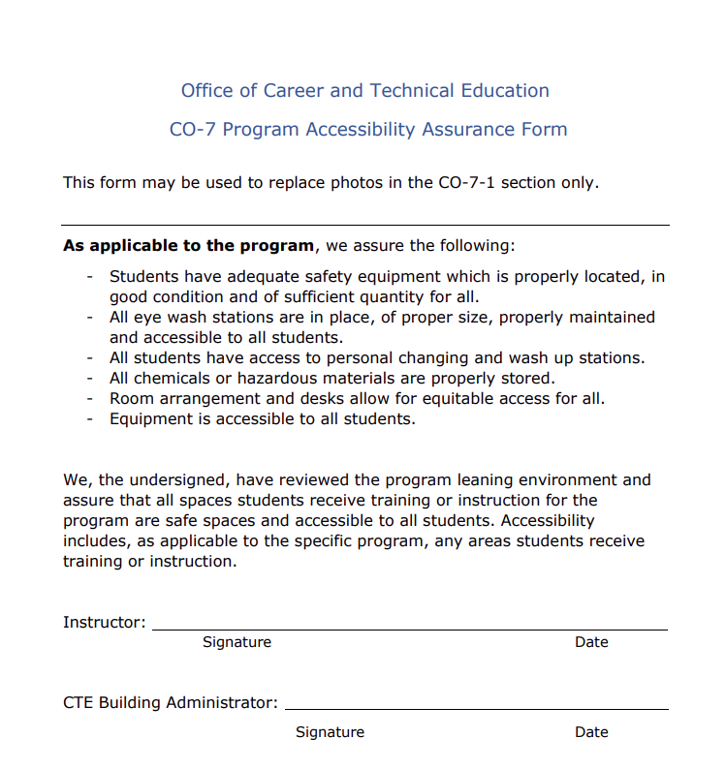
C07 Template

Slide 40
C08
Secondary - Postsecondary Sequencing, Credentials,
and Credit Agreements

Slide 41
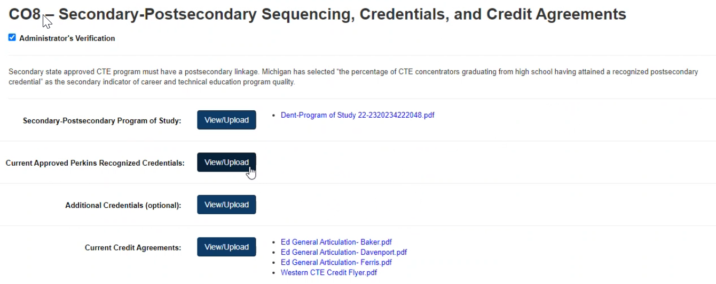
C08
Secondary - Postsecondary
Program of Study
Credentials

Slide 42
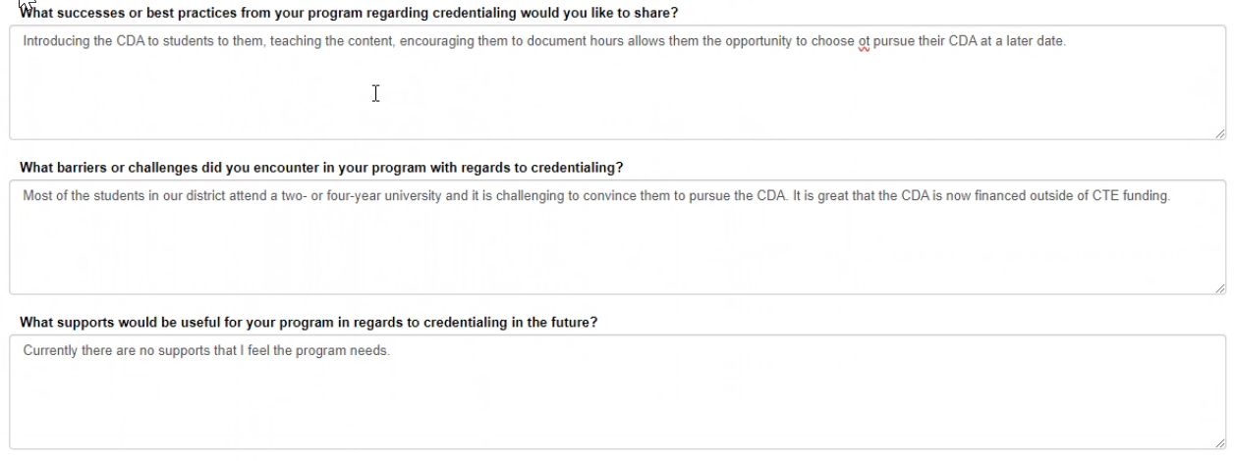
C08
Secondary - Postsecondary

Slide 43
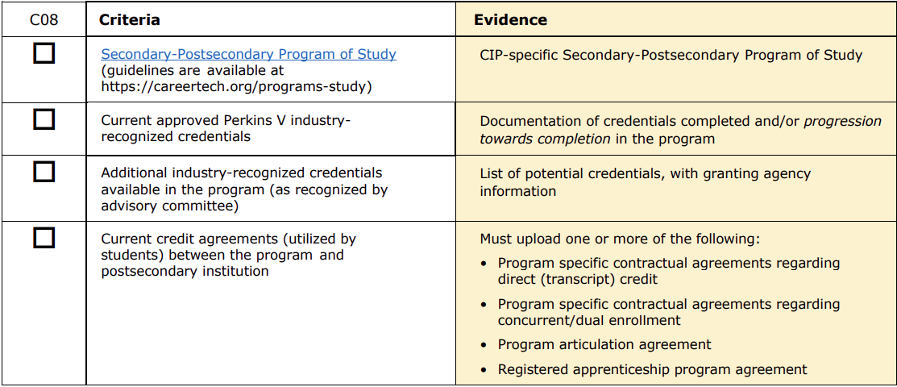
C08 Evidence
Update annually in May/June

Slide 44
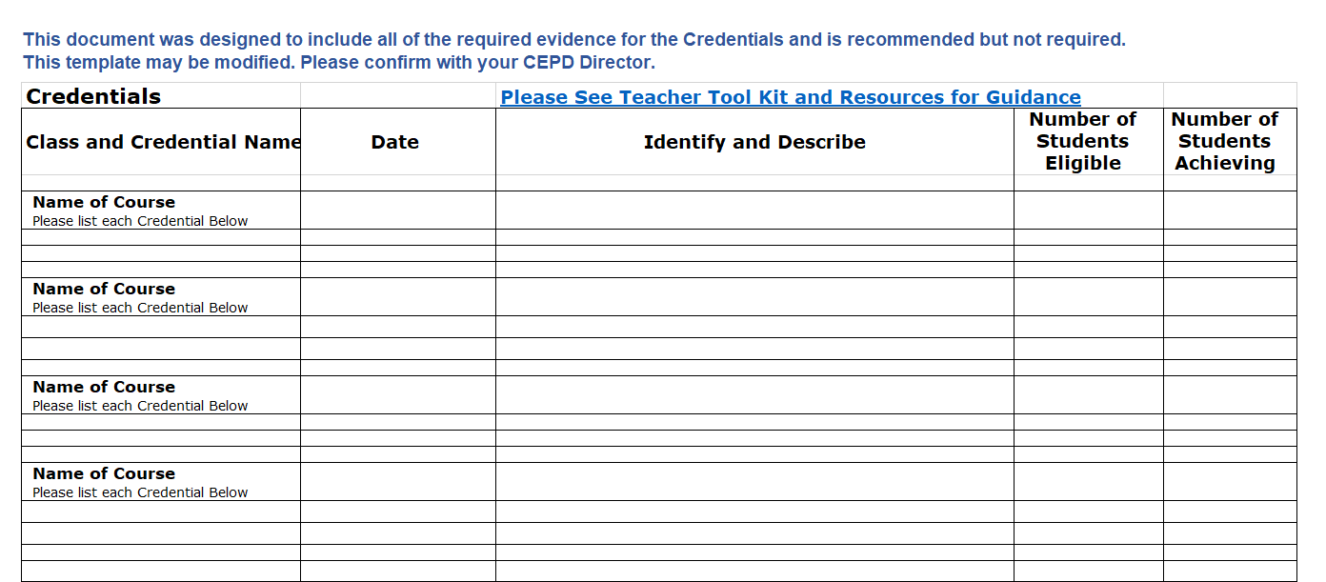
C08 Template
Can be generic versus specific
Description of credential
Notes:
Hand it over to Jim to bring it home.

Slide 45
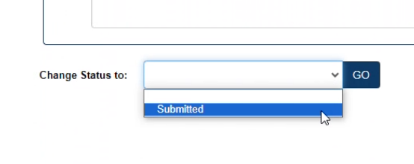
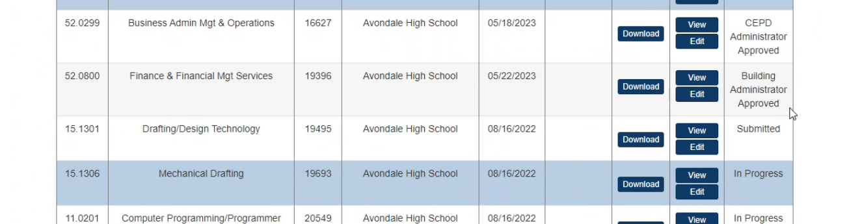
CIP Status Review

Slide 46

Technical Issues
Help Desk:
MDE-GEMS@Michigan.gov
CC: Program Consultant

