Slide 1
A diesel truck equipped with a JWAC (Jacket Water Aftercooler) has low power under load. Which of the following could be the cause?
A
Leaking JWAC (Jacket Water Aftercooler)
B
Leak in turbocharger inlet piping
C
Using an off road grade of fuel
D
Open in EGR sensor circuit
>
tekhnologic

Slide 2
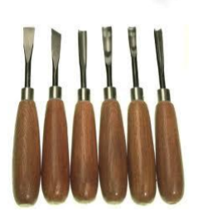
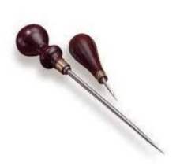
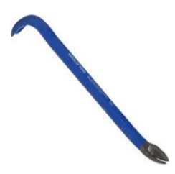
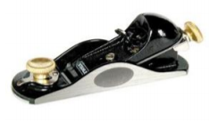
Tool identification? Which of the following is a Gouge
A
B
C
D
>
tekhnologic

Slide 3
A medium duty truck using a HEUI (hydraulically actuated electronically controlled unit injector) fuel system has a misfire code when hot. Technician A says worn HEUI injectors could be the cause. Technician B says a shorted glow plug could be the cause. Who is right?
A
B only
B
A only
C
Both A and B
D
Neither A or B
>
tekhnologic

Slide 4
The technician gets an infinite ohms reading on the ohmmeter function of the DMM (Digital Multimeter), when measuring resistance in a circuit. Which of the following could be the cause?
A
Corroded terminal
B
Circuit is complete
C
Circuit is open
D
Circuit is in operation
>
tekhnologic

Slide 5
Technician A says you do not have to solder a repaired wire. Technician B says wire insulation damage is sometimes found where the wire passes through an opening in a metal part. Who is right?
A
A and B
B
A only
C
Neither A or B
D
B only
>
tekhnologic

Slide 6
The engine cranks on a diesel, but will not start. During diagnosis, the ECM (Electronic Control Module) will not communicate with the diagnostic tool. What is the MOST LIKELY cause?
A
Low ECM supply voltage
B
Failed data link connector
C
High ECM supply voltage
D
Incorrect diagnostic tool software
E
No ECM supply voltage
F
Outdated diagnostic tool software
>
tekhnologic

Slide 7
Which of the following measuring tools is MOST likely used to measure the temperature of the diesel exhaust gases?
A
Exhaust pyrometer
B
Exhaust manometer
C
Diagnostic scan too
D
MDI (Multiple Diagnostic Interface)
E
OBD II & CAN Deluxe Scan Too
F
Dual – MDI (Multiple Diagnostic Interface)
G
Tachometer
H
Contact Infrared Thermometer
>
tekhnologic

